Slide 1

Caught Infrared Handed
Grace Fu, Elishia Diokno, michal Roztocki

Slide 2
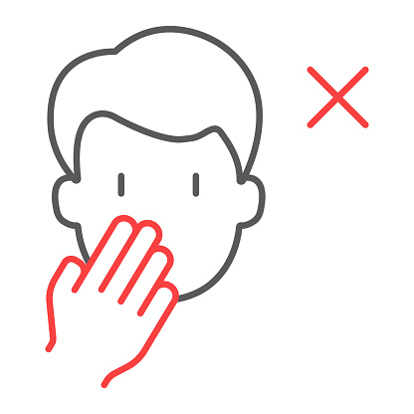


Problem
+
=
On average you touch your face
every hr
Viruses can live on surfaces for
23x
weeks

Slide 3
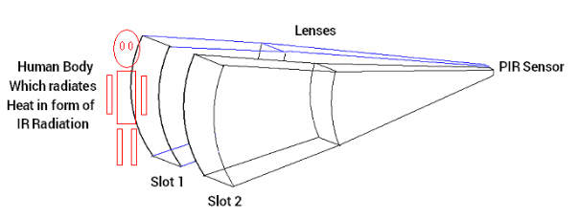
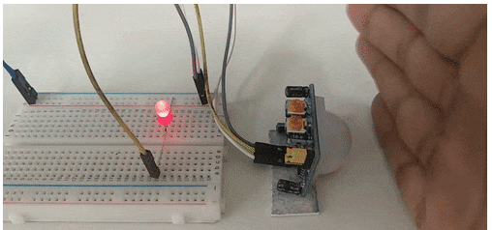
Infrared Sensing Technology

Slide 4

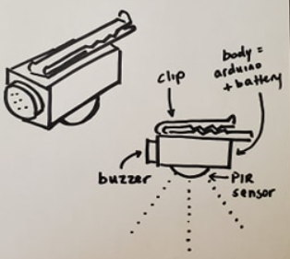
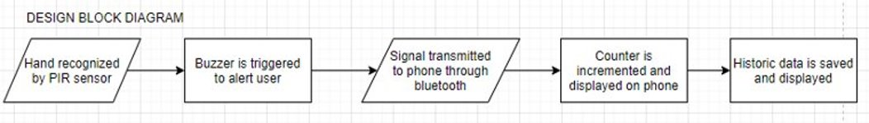
Infrared Sensing Technology

Slide 5
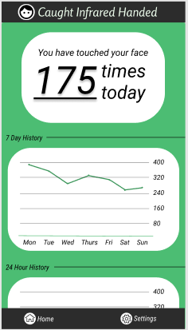
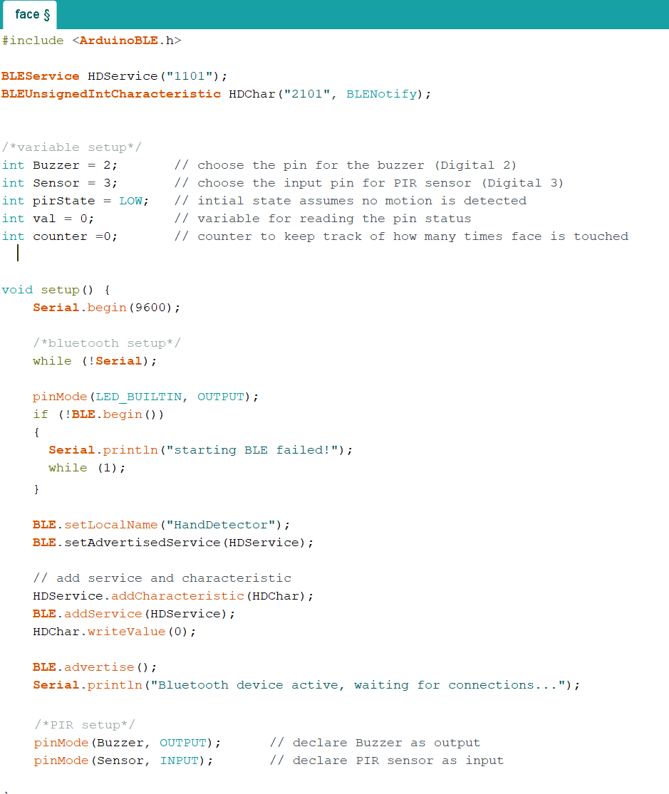
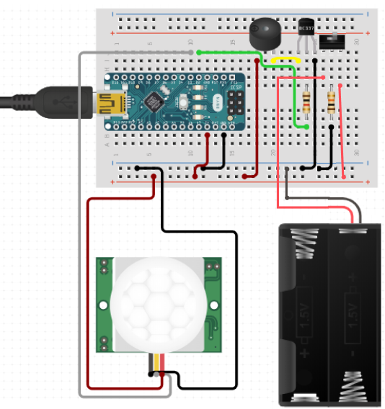
Implementation

Slide 6
Next Steps of Development
Prototype & Testing
App Development

Slide 7
Caught Infrared Handed
Hands down the best way to keep your hands down

